Slide 1
AI – Based Speech Recognition System For Smart Devices
TEAM MEMBERS:
19R21A0462 – B . Sai Kiran
19R21A04B0 – Satya Prakash Dash
19R21A0463 – B . Shashanth
19R21A0497 – O . Pradeep
Project Guide: Mr. Bittu Kumar(Assistant Professor)

Slide 2


List of Content
AIM AND OBJECTIVES
ABSTRACT
MOTIVATION
INTRODUCTION
LITERATURE SURVEY
COMPONENTS
PIN DIAGRAM
METHODOLOGY
EXPECTED WORKING
RESULTS
ADVANTAGES
CONCLUSIONS
FUTURE SCOPE
REFERENCES

Slide 3
AIM AND OBJECTIVES
AIM:
To embed a speech control interface for controlling the electrical devices.
OBJECTIVE:
Objective is to develop a low cost home automation system which is easy to install and configure.

Slide 4
Abstract
AI that mimic human intelligence to perform tasks and can iteratively improve themselves based on the information they collect.
ML is focused on building systems that learn or improve their performance based on the data they consume.
Smart Homes makes use of AI, and Internet of Things (IoT) devices such as connected sensors, lights, and meters. It helps to collect and analyze data.
Today, industry players such as Google, Apple and Amazon are more focusing on their smart assistants such as Google Assistance, Siri, Alexa where these work on ASR-Automated Speech Recognition

Slide 5
Cont..
Automatic Speech Recognition is the technology to process human speech into readable text. As ASR quickly approaches human accuracy levels.
Popular applications we use every day such as TikTok and Instagram for real-time captions, Spotify for podcast transcriptions, Zoom for meeting transcriptions, and more.
In this project, the advanced version of developed (to be developed by us) ASR technologies are to deploy in to hardware for estimating their real time performance

Slide 6
Motivation
The main motive of our project is to develop an automated device using AI based ASR system.
AI makes human interaction with devices easier as it includes reasoning, knowledge representation, planning and the ability to move & manipulate objects.
It also saves human time in daily life as it is automated and user can also operate it by sitting at one place as we added IOT feature to our model.

Slide 7
Introduction
Speech recognition :
Speech Recognition is the technology that allows human beings to use their voices to speak with a computer interface & converts human speech into readable text.
AI based Speech Recognition :
Speech recognition with AI means adopting digital assistants, automated support & human – robot interactions in the form of voice user interfaces (VUIs) to streamline their services.

Slide 8
Cont..
Smart Devices :
Smart device is an electronic device, generally connected to other devices or networks via different wireless protocols (such as Bluetooth, Zigbee, near-field communication, Wi-Fi, LiFi, or 5G)
IOT :
IoT stands for the ‘Internet of Things’. It refers to the innovation that empowers devices and appliances to convey over the internet.

Slide 9
Literature Survey
Journal Title :
Performance Enhancement of Automatic Speech Recognition System.
Institute of Electrical and Electronics Engineers(IEEE) ISSN:978-1-5090-6785-5/18/$31.00
Source : https://ieeexplore.ieee.org/document/8519839/

Slide 10
Cont..
This paper presents the design and implementation of IOT smart devices with an AI based ASR.
The implementation is based on an Arduino microcontroller, a speech recognition system with connectivity(IOT).
The features a secure user system and connects to the module through arduino. It can be used to send commands & perform a specific action based on received commands to turn on light, rotate servo motor.

Slide 11
Components
Arduino UNO
Voice Recognition Module
Microphone
LED’s
Jumper Wires
Resistor 330 ohm’s
Bread Board
Servo Motor
USB to TTL module
5V Battery

Slide 12
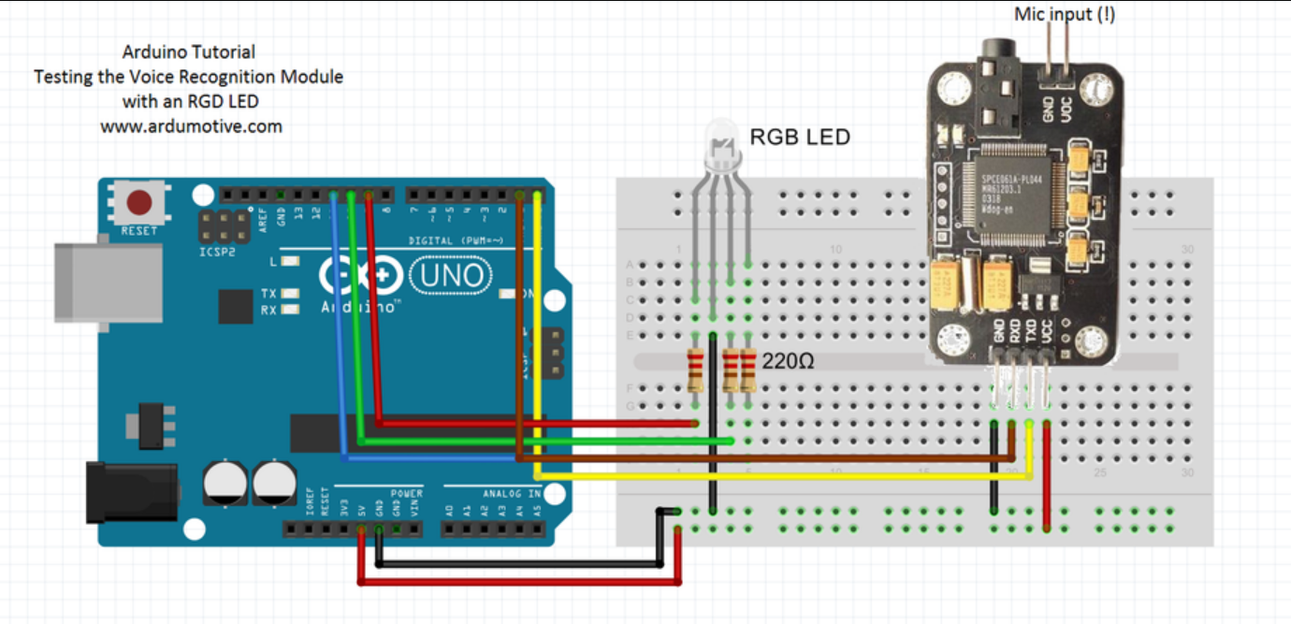
Pin Diagram

Slide 13
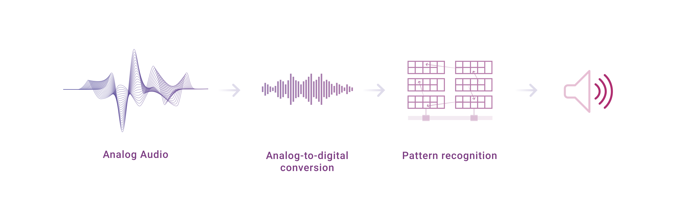
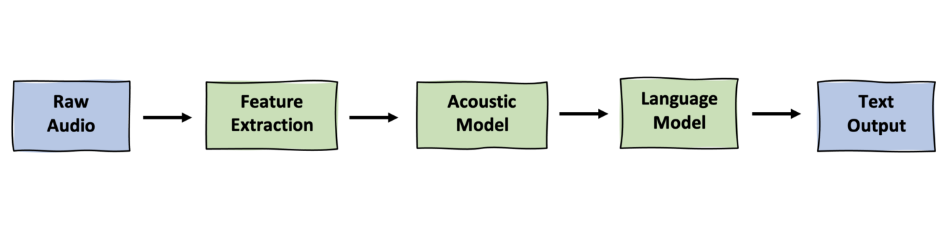
Methodology

Slide 14
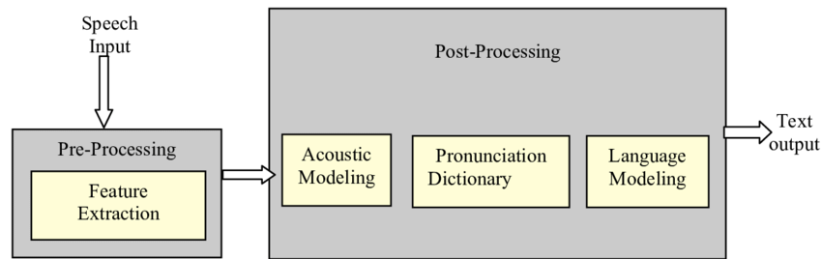
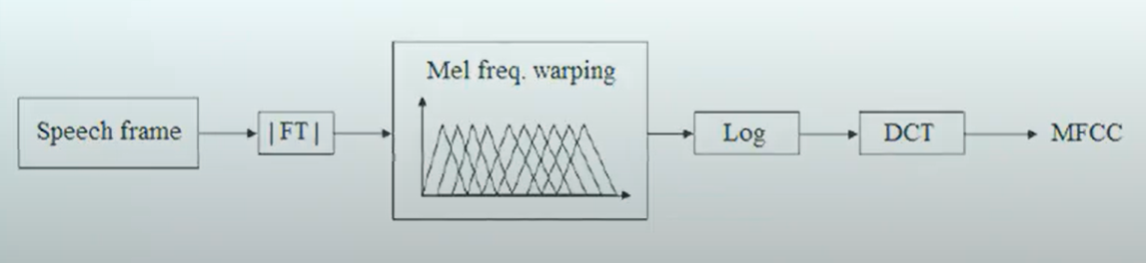
Feature Extraction
It is fundamental step in the Automatic Speech Recognition (ASR) process.
In this pre processing relevant data are extracted from a speech while removing background noise and irrelevant information.

Slide 15
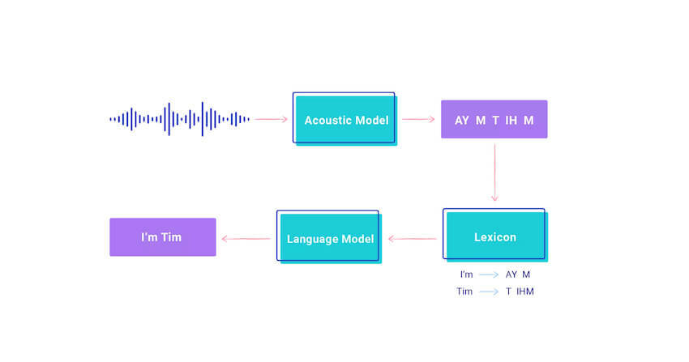
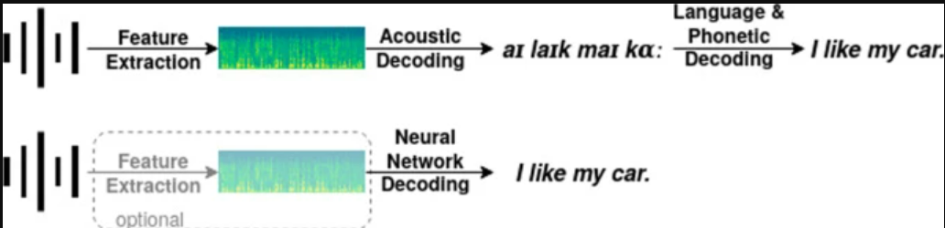
Acoustic Model
The acoustic model (AM), models the acoustic patterns of speech & maps raw data feature to phonemes based on accent .
The job of the acoustic model is to predict which sound or phoneme is being spoken at each speech segment from the forced aligned data by HMM or GMM.

Slide 16
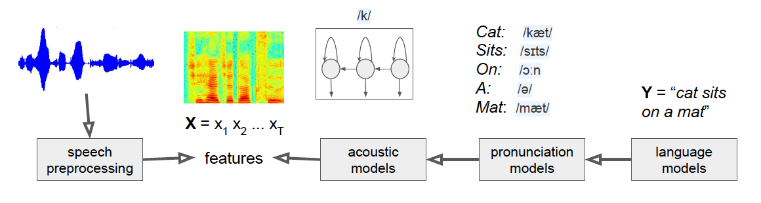
Lexicon Model
This is phoneme to word mapping.
This model contains pronounciation models which describes how words are pronounced phonetically.

Slide 17
Language Model
This defines how words are connected to each other in a sentence.
It learns which sequences of words are most likely to be spoken, and its job is to predict which words will follow on from the current words and with what probability & finally it produces output.

Slide 18
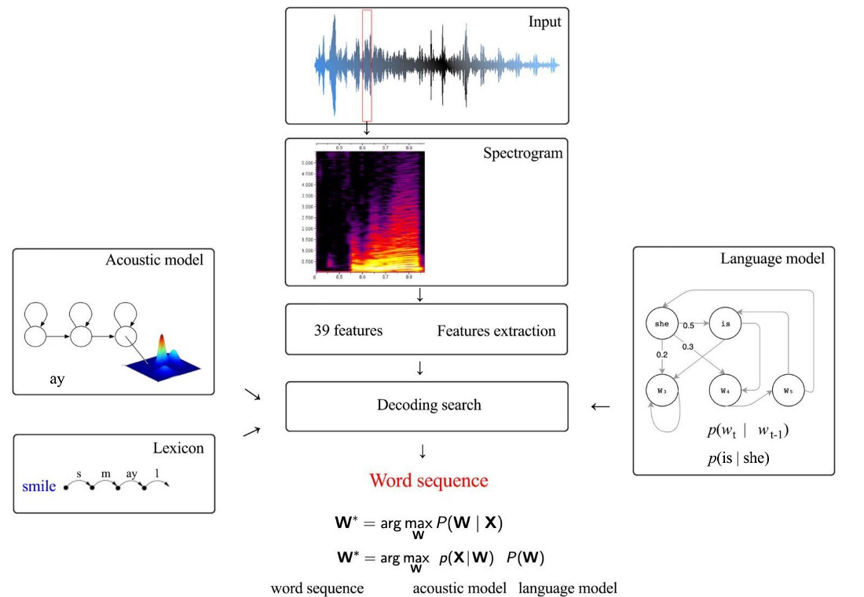
Proposed Methods
Implementation of ASR system :-
Training the model by acoustic, lexicon models.
Testing the model by language model.
At the end performance is evaluated by decoding.

Slide 19
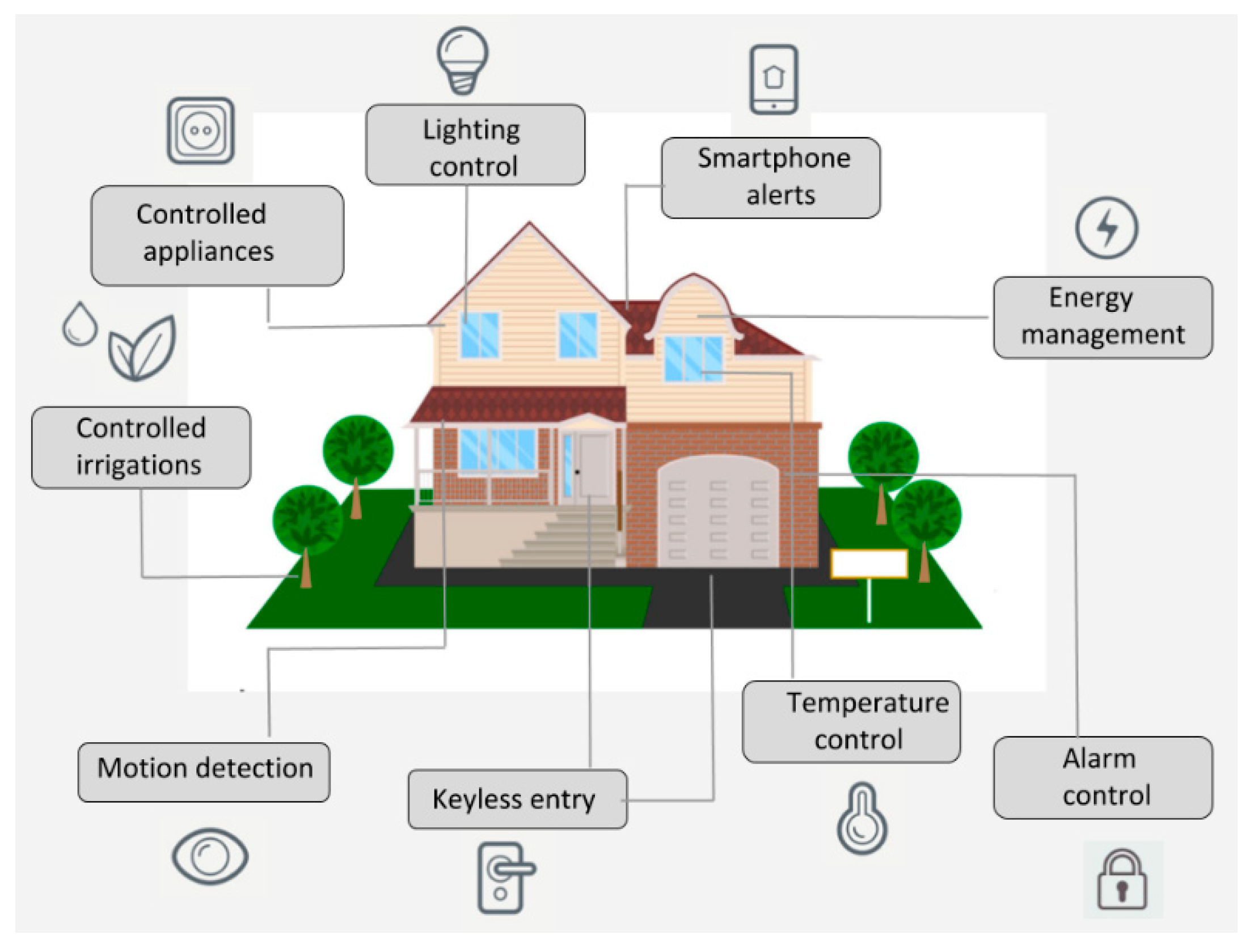
Cont..
Implementation in Hardware :-
In this project, the advanced version of developed (to be developed by us) ASR technologies are to deploy into hardware for estimating their real time performance.

Slide 20
Step by step process
1. Audio waves will be captured through microphone and amplified by the Voice recognition board.
2. The Recognition Module is trained and tested with the software Access Port to import commands in 3 – Groups of total 15 commands.
3. The Access port software recognize the commands,
4. There they will be trained & tested by following.
a. HEX AA 36 is used for common mode.
b. HEX AA 11 is used for recording mode.
c. HEX AA 21 is used for importing commands into module.

Slide 21
Cont..
5. Arduino UNO is programmed by C language through Arduino IDE for working of lights, servo motor, speaker etc.
6. Now Voice Recognition Module is connected to Arduino UNO and Arduino UNO is connected with 5V DC Battery.
7. Commands will be sent through microphone according to trained & tested model.
8. Based on this programmed model we give commands like “Red”, “Green”, “Blue”, “Rotate“.
9. The Arduino will identify the commands and perform the appropriate action.
10. The actions performed are turning on LED, Serve Motor, Speaker.

Slide 22


Expected working
Start
Raw audio(input) through mic to voice module.
Training
Testing
Voice & commands Recognized by Access port Software.
Commands imported into module after testing
Arduino uno is programmed.
Working of prototype i.e. lights, servo motor

Slide 24
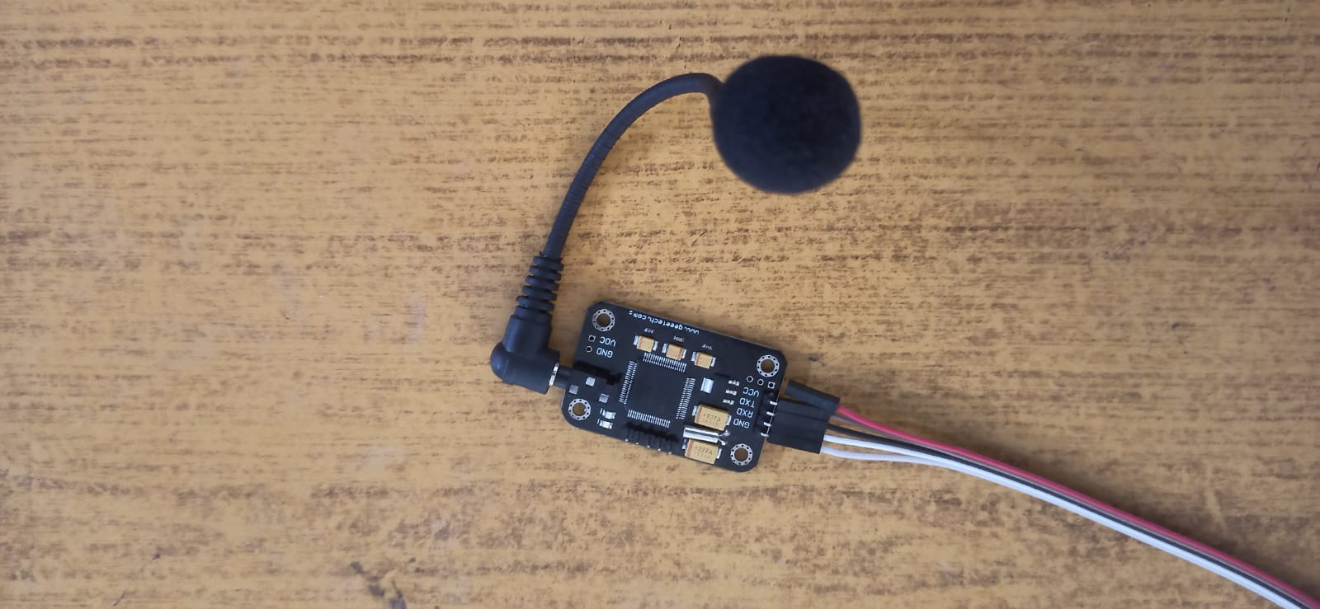
Results
Steps:
Step 1:
Audio commands will be sent & captured through microphone.

Slide 25
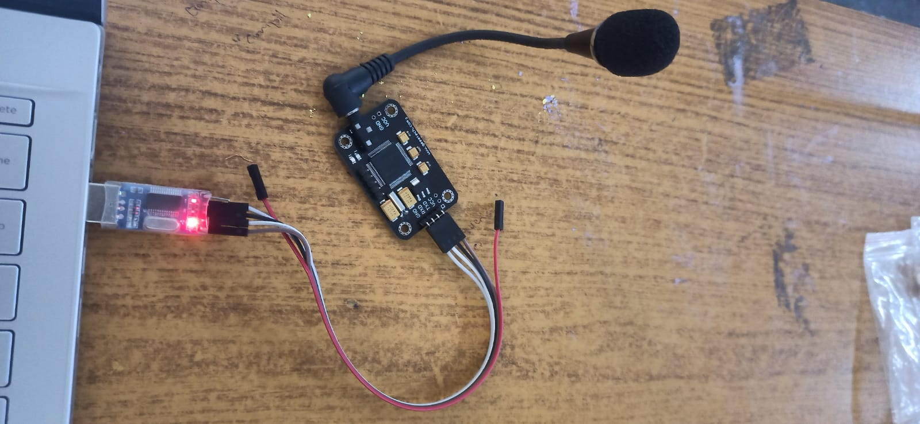
Cont..
Step 2:
The recognized commands will be loaded into software using TTL module.
In software by using HEX AA 21 the commands will be imported into voice recognition module.

Slide 26
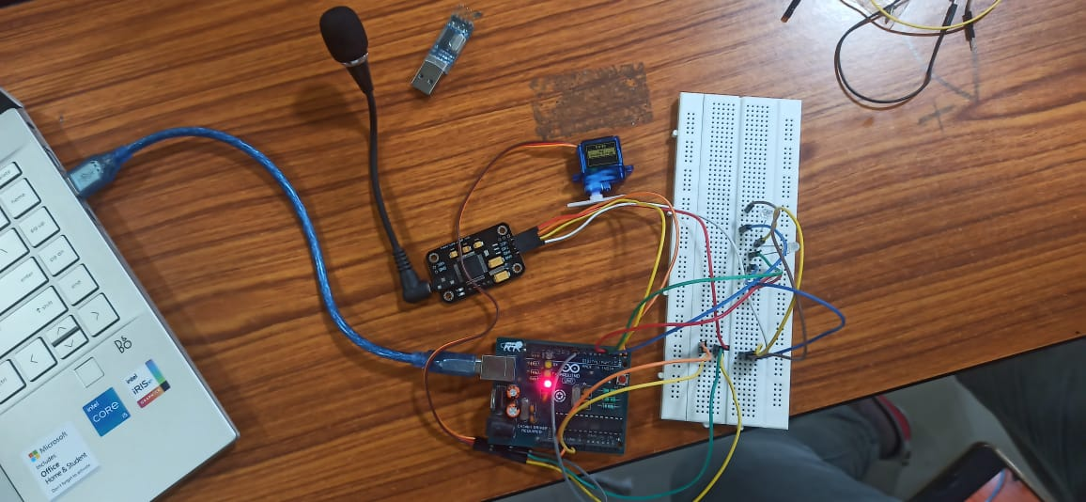
Cont..
Step 3 :
The Arduino will identify the commands and perform the appropriate action.
The actions performed are turning on LED, Serve Motor, Speaker.

Slide 27
Advantages
Helps those who have problems with speech or sight.
For pre-recorded audio, they can even run faster than real time e.g. they can be used to transcribe one hour of audio in 30 minutes or less.
It can capture speech much, faster than you can type.
The software can spell the same ability as any other writing tool.
It can help to increase productivity in many businesses.

Slide 28
Conclusions
This do work without text & can be operated through commands in smart way.
This saves a lot of time and makes it convenient and useful to the users.
It allows hand free work.
Controlling the home utilities via voice is just an amazing step forward towards the development in IoT sector

Slide 29
Future scope
This system can further be developed by including many features which are more likely to be present in advanced costly smart home devices in the market.
Those additional features include live monitoring of the events to check what’s going on.
By including additional features like Arduino SD card module, Raspberry PI which has inbuilt WIFI will be an absolute outstanding progress in this century,

Slide 30
References
M. R. Samburu, N. S. Jayant, "LPC analysis/synthesis from speech inputs containing quantizing noise or additive white noise", IEEE Trans. Acoustic. Speech Signal Processing, vol. ASSP-24, pp. 488-494, Dec. 2019.
Ram Singh, PreetiRao, “Spectral Subtraction Speech Enhancement with RASTA Filtering”, Proceeding of National Conference on Communications (NCC), Kanpur, India, 2007.
H. Doi, K. Nakamura, T. Toda, H. Saruwatari, K. Shikano, "Statistical approach to enhancing esophageal speech based on Gaussian mixture models," Proc. ICASSP2010, pp. 4250–4253 (2010).

Slide 31
THANK YOU

